Slide 1


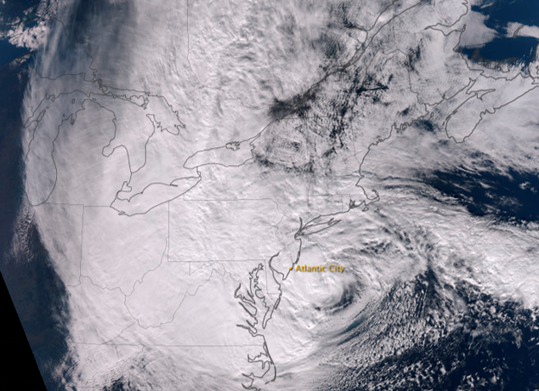
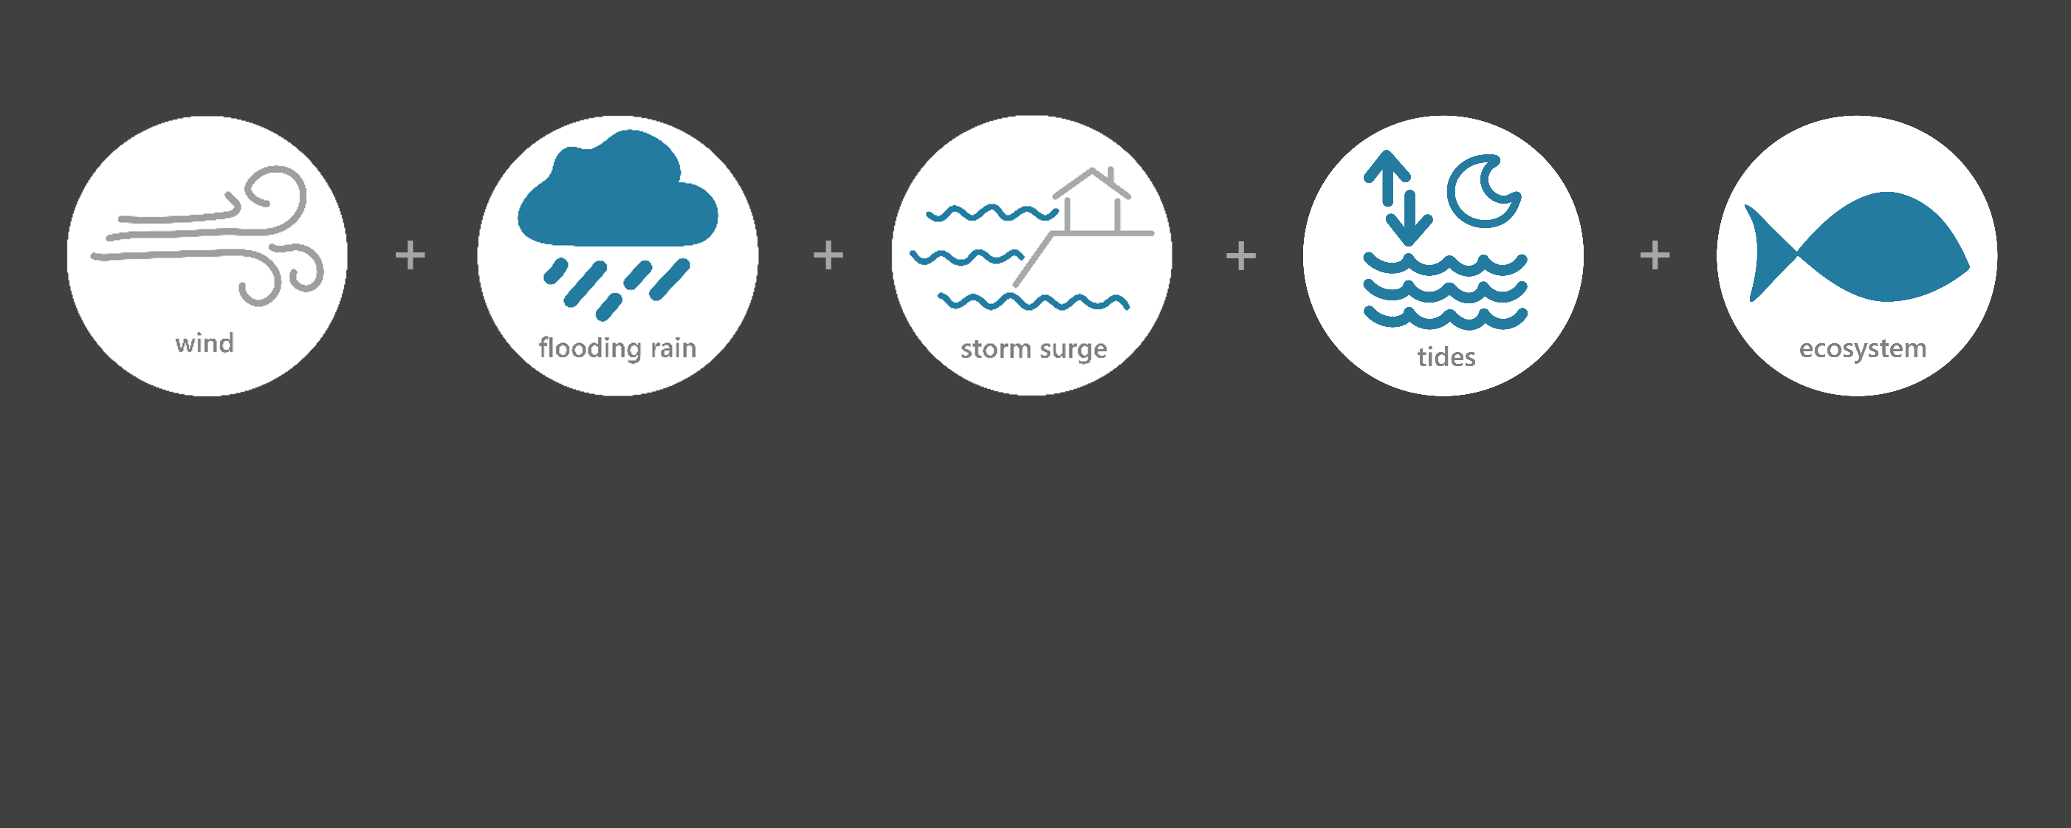
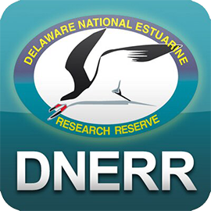
[ OCT 22 – OCT 30, 2012 ]
HURRICANE SANDY
ES
Category
(extratropical storm)
8.6
Inches of Rain
39
Miles per hour of Max Wind Speed
3-5
Feet of Storm Surge (max)*
Image Credit: NOAA, taken on October 29, 2012
Monitoring the Impact of Hurricane Sandy at “Delaware NERR”
Hurricane Sandy was the deadliest, most destructive, and strongest hurricane of the 2012 Atlantic season. Sandy made landfall near Atlantic City, New Jersey on Oct. 29. An unusual combination of hurricane conditions and cold fronts made Sandy particularly damaging. Lower Delaware experienced heavy rainfall, high winds, and flooding. NOAA estimates Sandy caused at least $80 billion (adjusted for 2022) in damages, making it the fourth costliest hurricane in U.S. history. The effects of Sandy were observed at the Delaware NERR (DNERR) Research Reserve through the System-Wide Monitoring Program (SWMP), which tracks short-term variability and long-term change of weather and water quality in the areas surrounding Dover and Kent County, Delaware.
Data shown are based on the DNERR weather monitoring site
Based on National Ocean Service (NOS) stations
Created on April 25, 2022

Slide 2

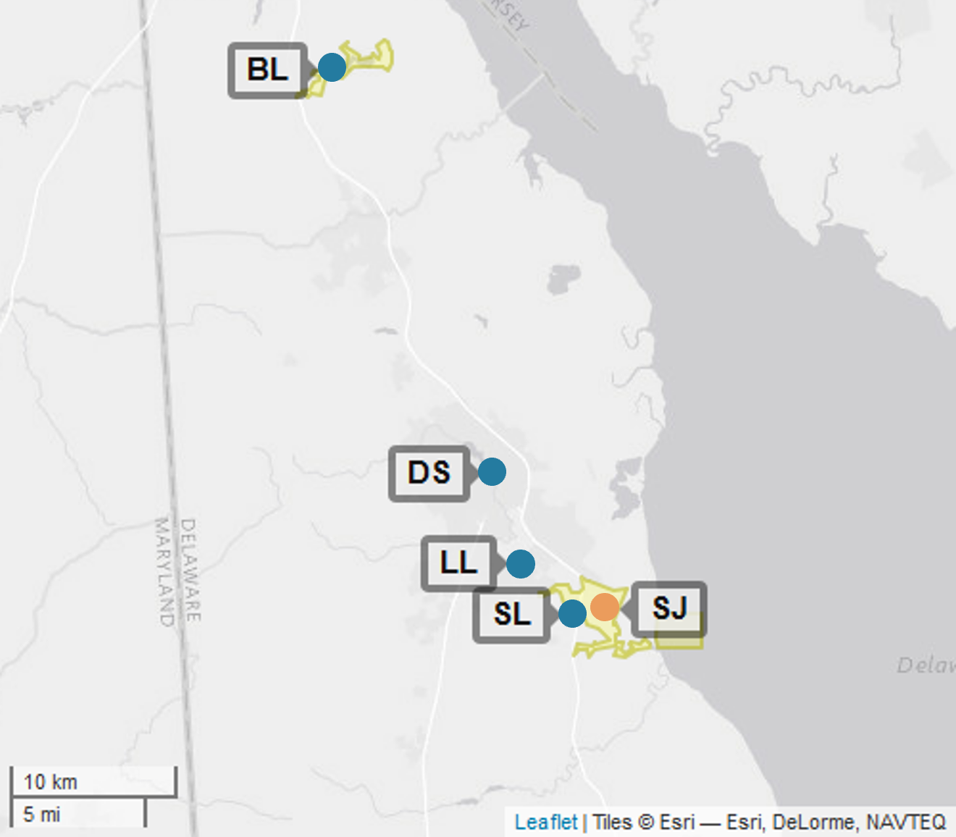
DNERR
Delaware NERR (DNERR) is one of 29 sites in the National Estuarine Research Reserve Systems (NERRS). Each site is a state-federal partnership that combines research, monitoring, and education to advance the understanding and management of estuarine environments.
DNERR
NERRS
Centralized Data
Management Office
DNERR Storm Monitoring
Weather Station
DNERR operates a weather station located in Saint Jones River (SJ) and maintains four continuous, long-term water quality stations at Blackbird Landing (BL), Division Stree (DS), Lebanon Landing (LL), and Scotton Landing (SL) locations. DNERR is part of the SWMP. As Hurricane Sandy approached Delaware, DNERR monitored the weather and water quality, collecting data every 15 minutes for the following parameters: air temperature, relative humidity, atmospheric pressure, rainfall, wind speed and direction, water temperature, depth, salinity, dissolved oxygen, turbidity, and pH.
Water Quality Sample Location

Slide 3
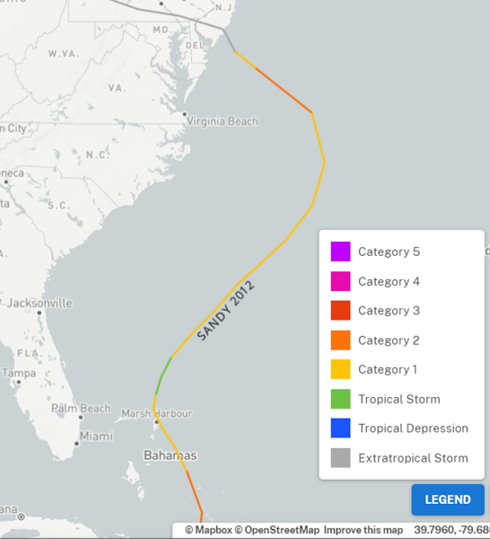
Sandy formed in the Caribbean Sea on Oct. 22. The hurricane was a Category 1 as it moved north along the Carolinas on Oct. 28, strengthened to a Category 2 as it turned toward the East Coast, and weakened to an extratropical storm when it made landfall on Oct. 29 near Atlantic City, New Jersey.
Delaware experienced heavy rains and storm surges that resulted in record flooding, thousands of people lost power, and dunes were breached.
Source: https://oceanservice.noaa.gov/news/historical-hurricanes/
DNERR
Damage and losses due to Sandy’s impacts on the U.S. totaled $80 billion. Delaware's Prime Hook National Wildlife Refuge underwent a $38 million restoration effort to repair the marsh, restore the natural water flow, repair breaks in the existing dunes, and create a marsh and beach to withstand storms and impacts of climate change.
While Sandy was a Category 2 hurricane off the coast of the Northeastern United States, the storm became the largest Atlantic hurricane on record as measured by diameter, with tropical-storm-force winds spanning 1,150 miles (1,850 km).
Aquatic life (i.e., oysters, crabs, lobster, fish, aquatic plants, phytoplankton) rely on specific levels of salinity, dissolved oxygen, and turbidity to thrive and survive. The water quality in the reserve was impacted by Sandy with significant drops in salinity levels and increases in turbidity levels for varying periods of time, potentially stressing organisms.
Station | Date | Total Precipitation (in) | Average Air Temp. (deg. F) | Max Wind Speed (mph) | Average Wind Speed (mph)
Saint Jones River | 10/28/2012 | 0.59 | 56.9 | 25.3 | 15.9
Saint Jones River | 10/29/2012 | 6.79 | 52.3 | 37.6 | 24.8
Saint Jones River | 10/30/2012 | 1.20 | 45.0 | 38.9 | 21.0
Saint Jones River | 10/31/2012 | 0.02 | 44.9 | 15.9 | 7.3
Saint Jones River | 11/1/2012 | 0.00 | 44.5 | 15.2 | 6.1
The highest local rainfall and wind measurements were recorded when Sandy approached Delaware and made landfall in Atlantic City, New Jersey.
Data reporting time periods for Hurricane Sandy: 10/28/2012 - 11/1/2012

Slide 4
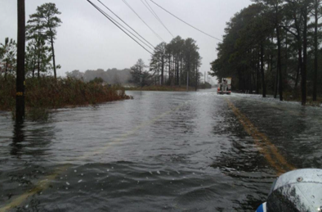
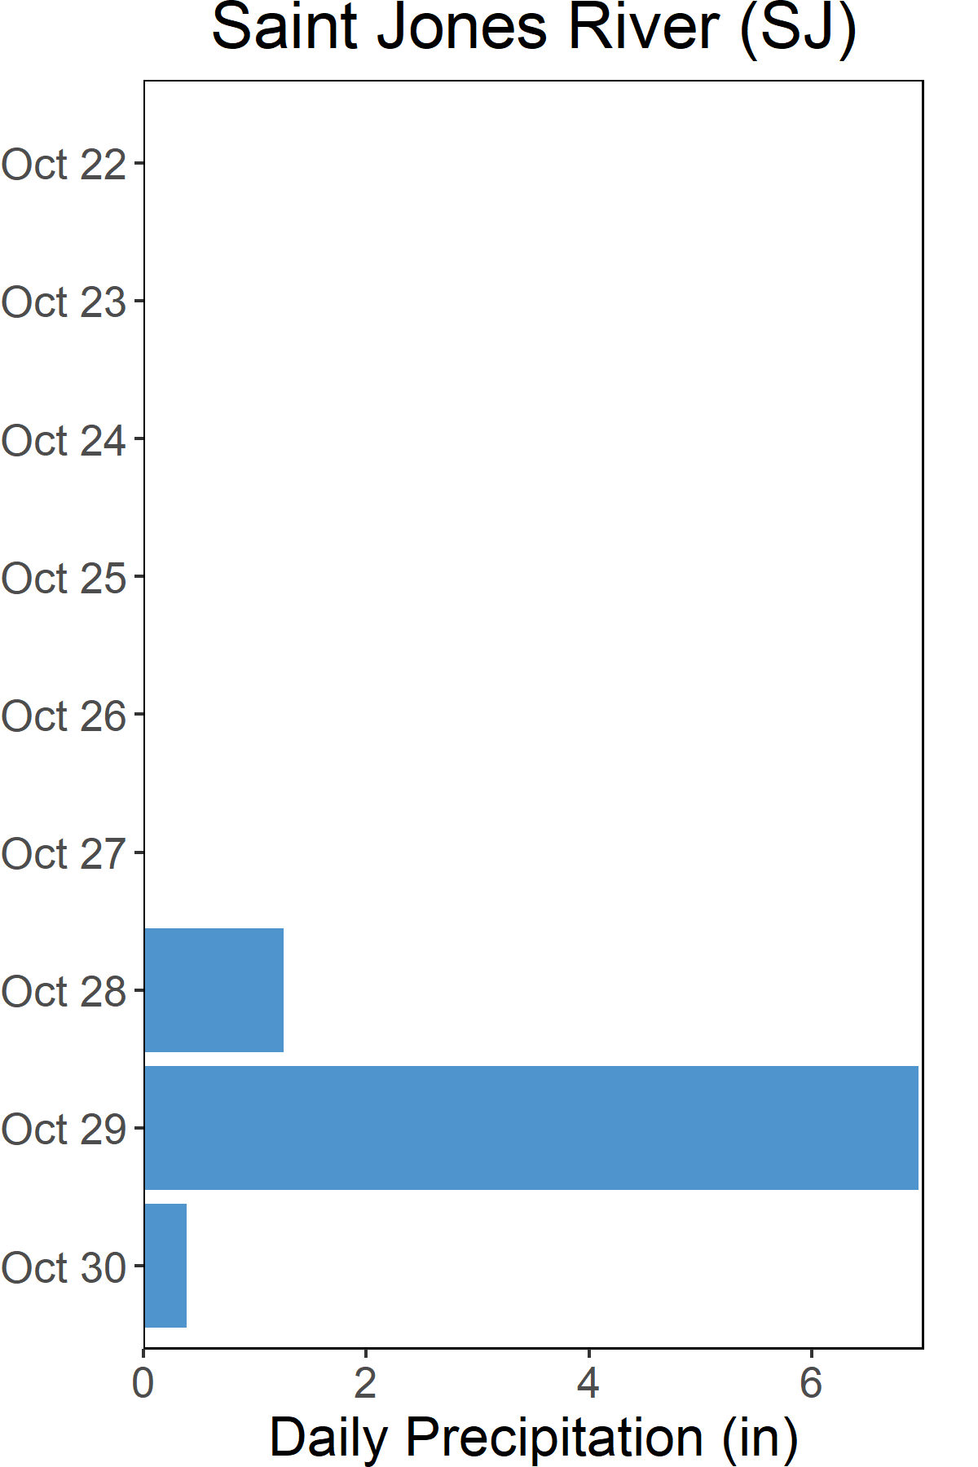
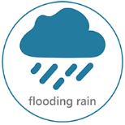
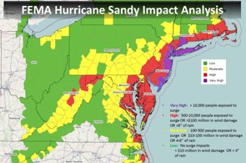
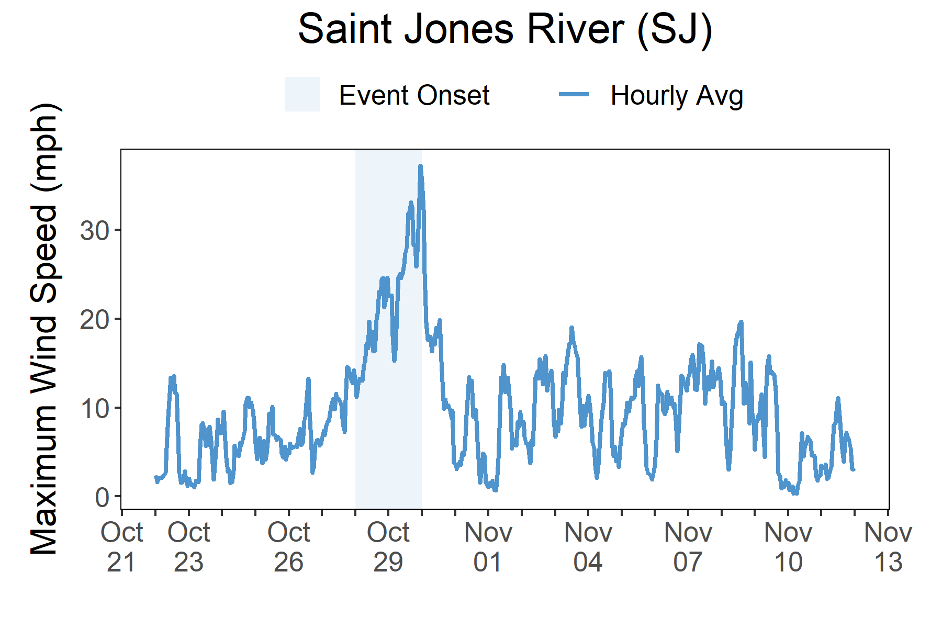

Rainfall
Florence brought heavy rains and freshwater and storm surge flooding to Delaware.
A total of 8.6 inches of rainfall fell in the reserve area over the course of three days as a result of the heavy rain-producing Hurricane Sandy. A combination of heavy local rain and storm surge resulted in flooding.
Photo from Eric Blake, National Hurricane Center (NHC), taken in Sussex County.
Impacts to Delaware from Hurricane Sandy resulted in property damage, street flooding, power outages, dune breaches, and beach erosion. Heavy rains fell over Delaware with 8.6 total inches of rainfall recorded at the St. Jones River weather station. The combined effect of storm surge and a full moon high tide produced max inundation levels of 3-5 ft in areas along the coastline. The highest storm surges recorded by the National Ocean Service (NOS) gauges in Delaware were 5.99 ft above normal tide levels at Delaware City and 5.80 ft at Reedy Point. The maximum wind speed recorded at the St. Jones River weather station was 39 mph.
Sandy is often described as an anomaly as several factors were at play, including the rare track, the large size of the storm, a higher-than-usual full moon high tide, and a cold front that resulted in a hybrid of two storm systems. For many, it was a call to action to take a hard look at the vulnerability of coastal communities and the reality that coastal storms are intensifying, and that sea-level rise and climate change will only heighten the risk in the future.
Rainfall measurements at the St. Jones River weather station from Oct. 22 through Oct. 30.
Wind Speed
Max wind speed recorded at the reserve was ~39 mph on Oct. 30.
Maximum Wind Speed readings at the St. Jones River weather station from Oct. 22 through Oct. 30.

Slide 5
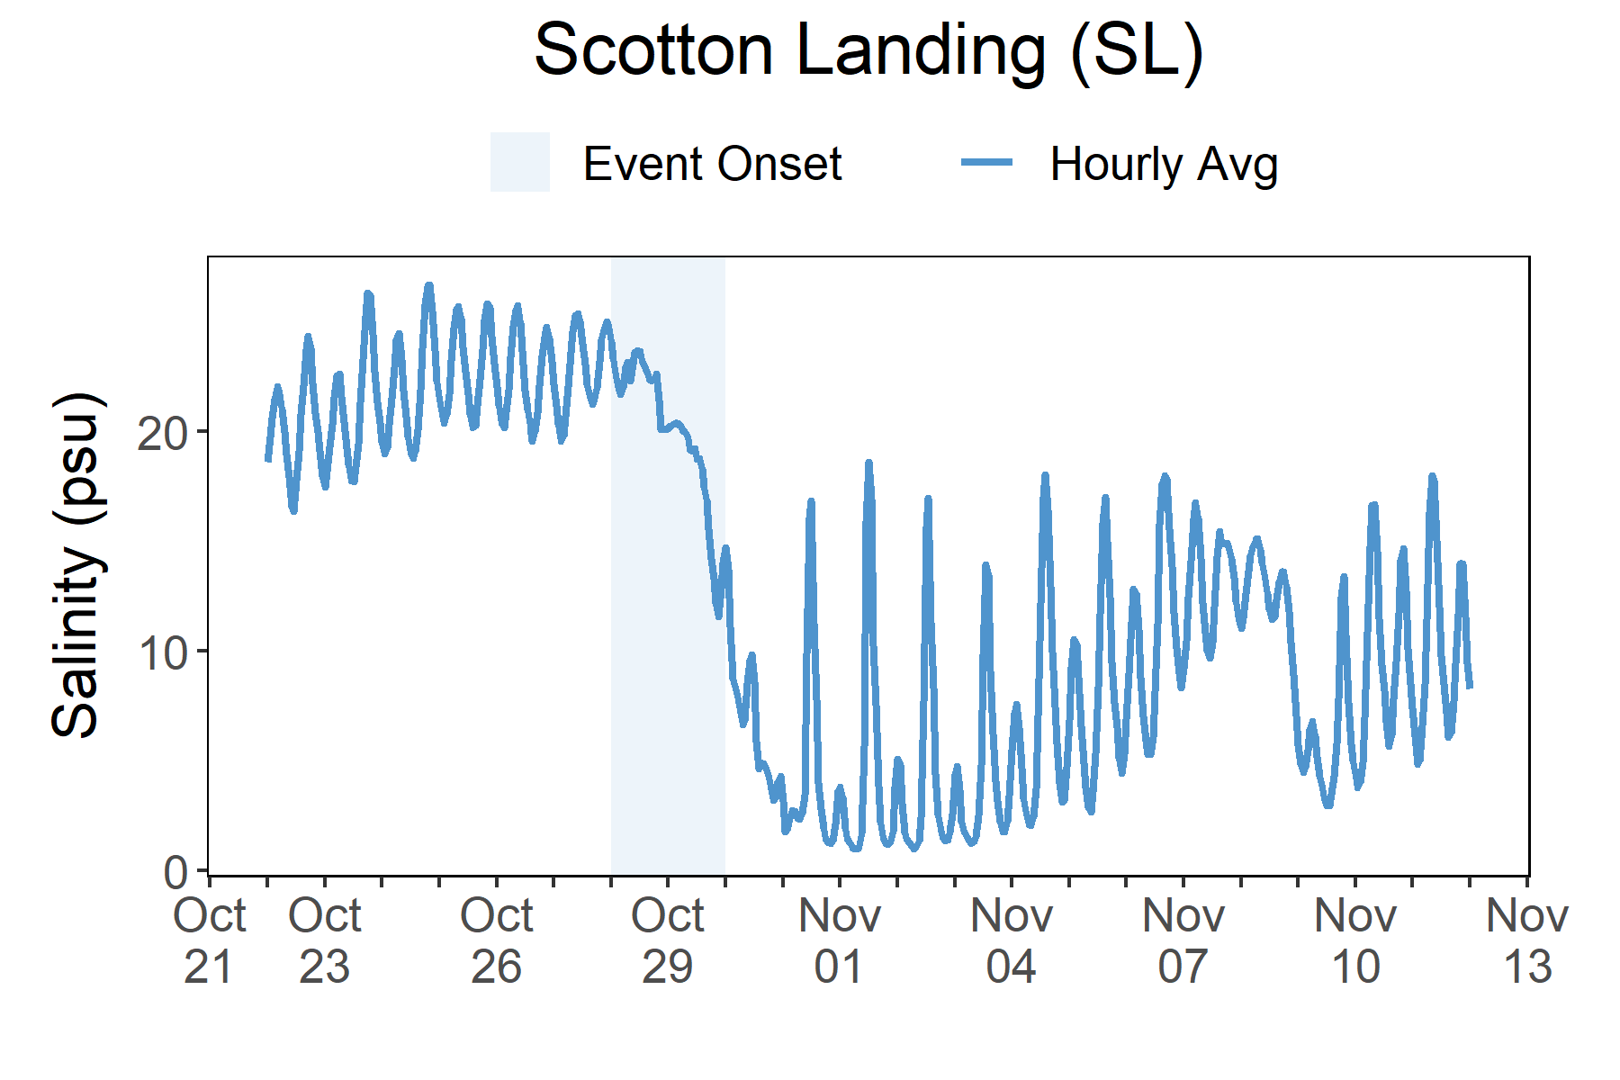
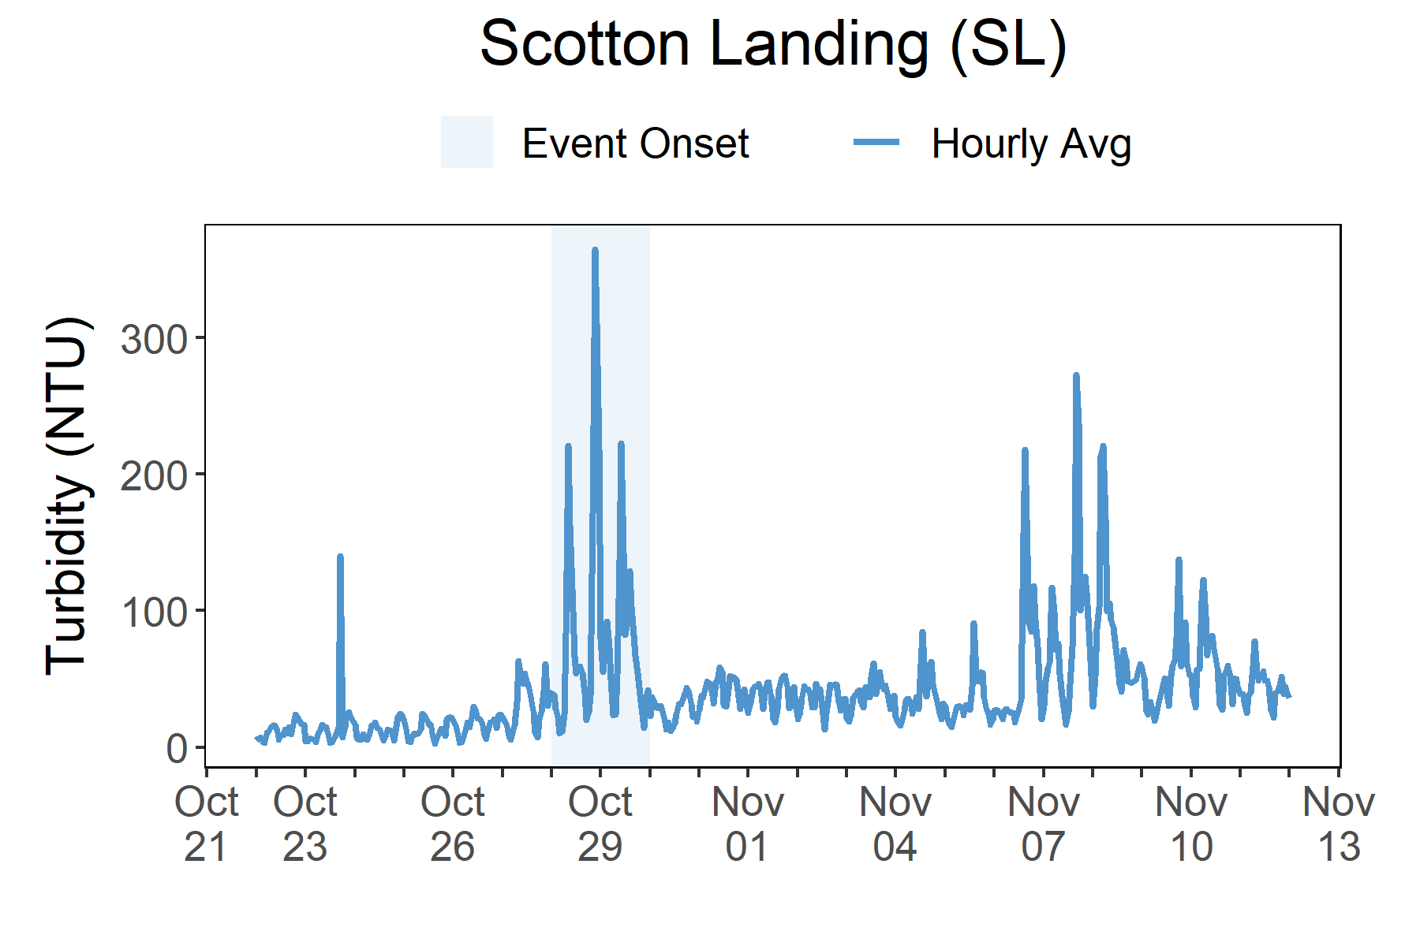
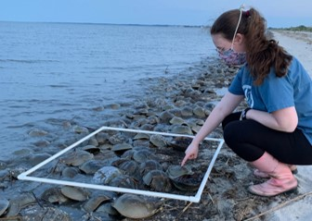
Salinity levels quickly dropped at Scotton Landing (SL) as Sandy passed through the reserve and then remained low as freshwater flooding came to the area over several days.
Station | Date | Turbidity Maximum (NTU) | Salinity Minimum (psu) | Salinity Maximum (psu) | Dissolved Oxygen Minimum (mg/L) | Dissolved Oxygen Maximum (mg/L)
Scotton Landing | 10/28/2012 | 258 | 21.7 | 25.1 | 4.4 | 7.2
Scotton Landing | 10/29/2012 | 405 | 13.8 | 22.7 | 5.5 | 8.0
Scotton Landing | 10/30/2012 | 57 | 4.1 | 14.9 | 6.4 | 7.4
Scotton Landing | 10/31/2012 | 65 | 1.4 | 17.1 | 6.0 | 7.6
Scotton Landing | 11/1/2012 | 57 | 1.0 | 18.8 | 6.1 | 7.7
Data reporting time periods for Hurricane Sandy: 10/28/2012 - 11/1/2012
Salinity
Turbidity
Post-Storm
Levels ~1-16 psu
Max Turbidity = 405 NTU
Pre-Storm Levels
average was
~14 NTU
Post-Storm Levels average was
~35 NTU
Pre-Storm
Levels ~16-26 psu
Min Salinity = 1 psu
Salinity levels from Oct. 22 to Nov. 12.
Turbidity levels from Oct. 22 to Nov. 12.
Salinity and Turbidity levels that were recorded at the Scotton Landing (SL) station show initial and post-storm impacts on water quality in this area. Salinity levels quickly dropped at the onset of the storm and recovered slightly as the storm moved on but remained lower than normal for an extended period of time. Turbidity levels (i.e., particles suspended or dissolved in water like sediment such as clay and silt) show a sharp increase at the storm onset but recover shortly as the storm moved on.
Dramatic changes in water quality such as salinity and turbidity can cause stress to some aquatic organisms depending on the species and how long the levels deviate from what is normal. Water quality stresses can impact survival and future populations.
Understanding plant and animal species habitat preferences is critical to understanding populations.

Slide 6
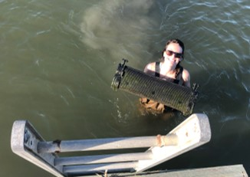
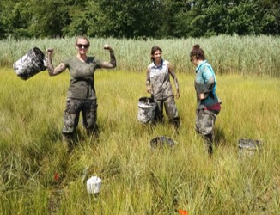
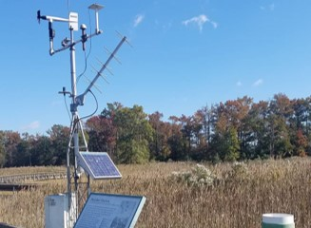
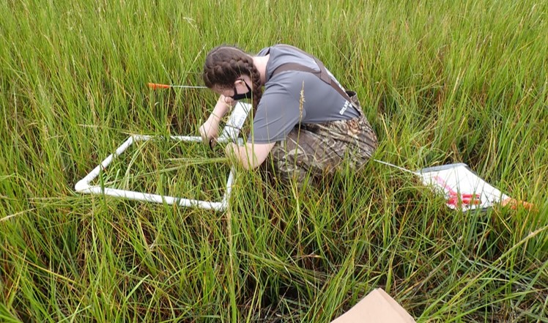
Kari St. Laurent, Phd, Research Coordinator (DNREC) e: Kari.StLaurent@delaware.gov p: 302-735-3413
Visit www.nerrsdata.org to view and download weather and water quality data from Delaware NERR.
Interested in learning more? Visit https://dnrec.alpha.delaware.gov/coastal-programs/research- reserve/. For video, news updates, online storm data and prediction visualization tools, check out our Storm Story Map at www.storm storymap.url.
@DNERR

